Slide 1
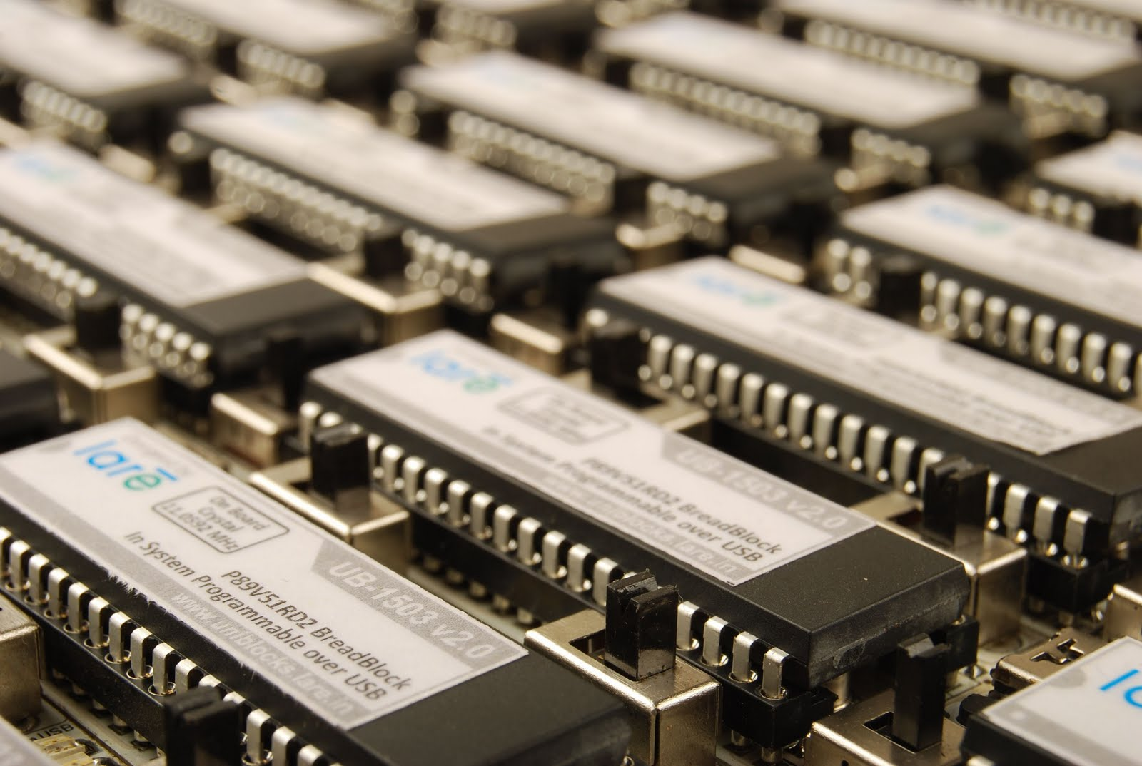
DON BOSCO INSTITUTE OF TECHNOLOGY Department of Electronics and Communication Engineering
SUBJECT : 8051 MICRONTROLLER
TOPIC : NSU-CSE331-PASSWORD BASED DOOR LOCKED USING-8051 MICRONTROLLER
Presented By:
AMBIKA A S[1DB22EC011]
AMULYA S GUPTA[1DB22EC013]
HARSHITHA G[1DB22EC055]

Slide 2
INTRODUCTION
A microcontroller based door locked is an access control system that allows only authorized persons to access a restricted area.
Nowadays most of the systems are automated in order to face new challenges and present day requirements to achieve good results. Automated systems have less manual operations, so that the flexibility, reliabilities are high and accurate.
The system has a keyboard by which the password can be entered thorough it.When the entered password equals with the password stored in the memory then the door gets open. If we entered a wrong password then the alarm is switched on.

Slide 3
HARDWARE REQUIRMENTS
80C51 Microcontroller
Programming cable
4*3 matrix keyboard
16*2 LCD
DC motor
Capacitor
Crystal
L293D-Push-Pull four channel driver with diodes
Sounder
Power
Ground

Slide 4
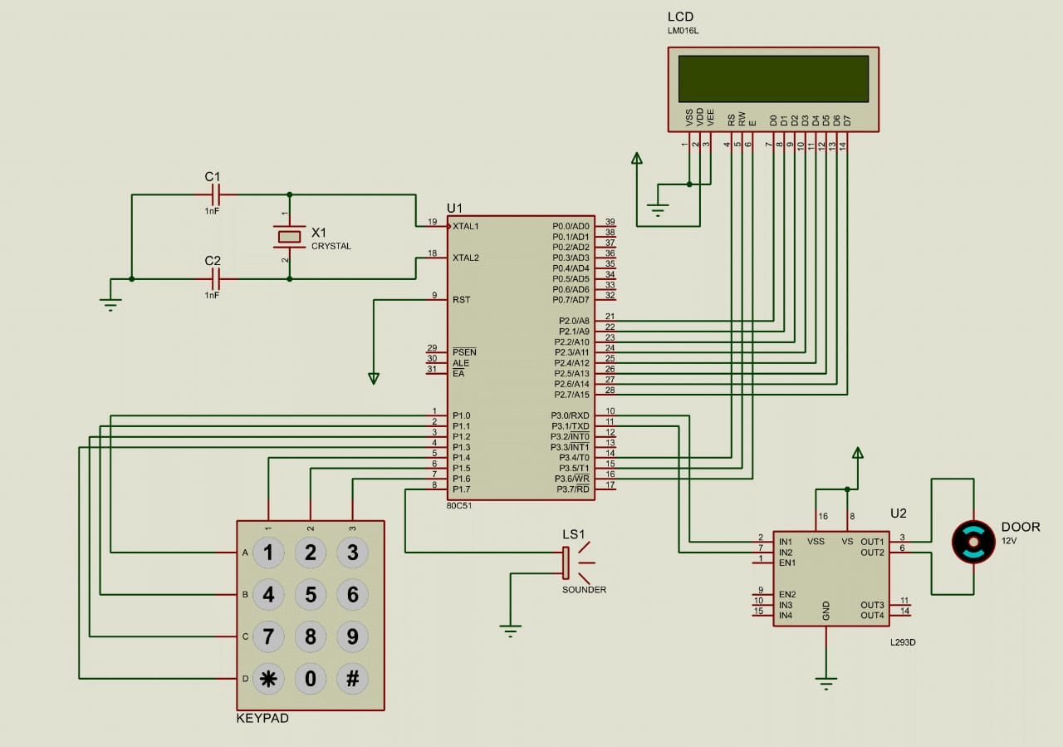
CIRCUIT DIAGRAM

Slide 5
WORKING
Reset circuit design
Oscillator circuit design
L.C.D
D.C Motor
4*3 matrix keyboard
Buzzer or any alarming element

Slide 6
APPLICATIONS
Residential buildings
Offices and educational institutions
Healthcare facilities
Government buildings
Data centers
Retail stores
Gyms and fitness centers
Parking garages
Research facilities

Slide 7
ADVANTAGES and DISADVANTAGES
Advantages:
Security
Convenience
Customization
Remote access
Easy to change
Integration with other system
No risk of key loss
User-friendly
Cost-effective
Disadvantages:
Security vulnerabilities
Risk of unauthorized access
Limited user accountability
Password sharing
Maintenance and management
Risk of phishing attacks
Technological limitations

Slide 8
CONCLUSION
Password based door locking security system is used to secure lockers and other protective doors, and also used in the places where we need more security.
The microcontroller continuously monitor the keypad and if somebody enters the password it will check with the entered password with the password stored in the memory and if it same then the microcontroller will switch on the corresponding device.
The system will allow the person who knows the password and it will not allow who don’t know the password.

Slide 9
THANK YOU!!!

